Slide 1
Traffic Sign Recognition Application
Team 7 Sponsored by: The PFW CS Department
Advisor: Mohammadreza Hajiarbabi

Slide 2
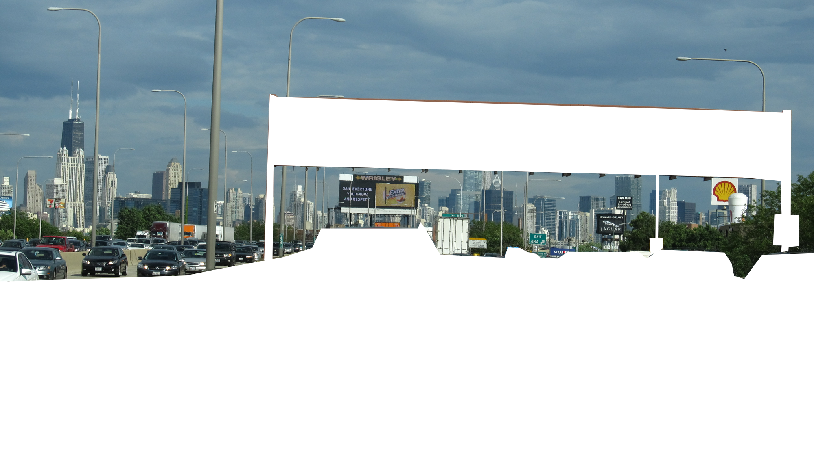
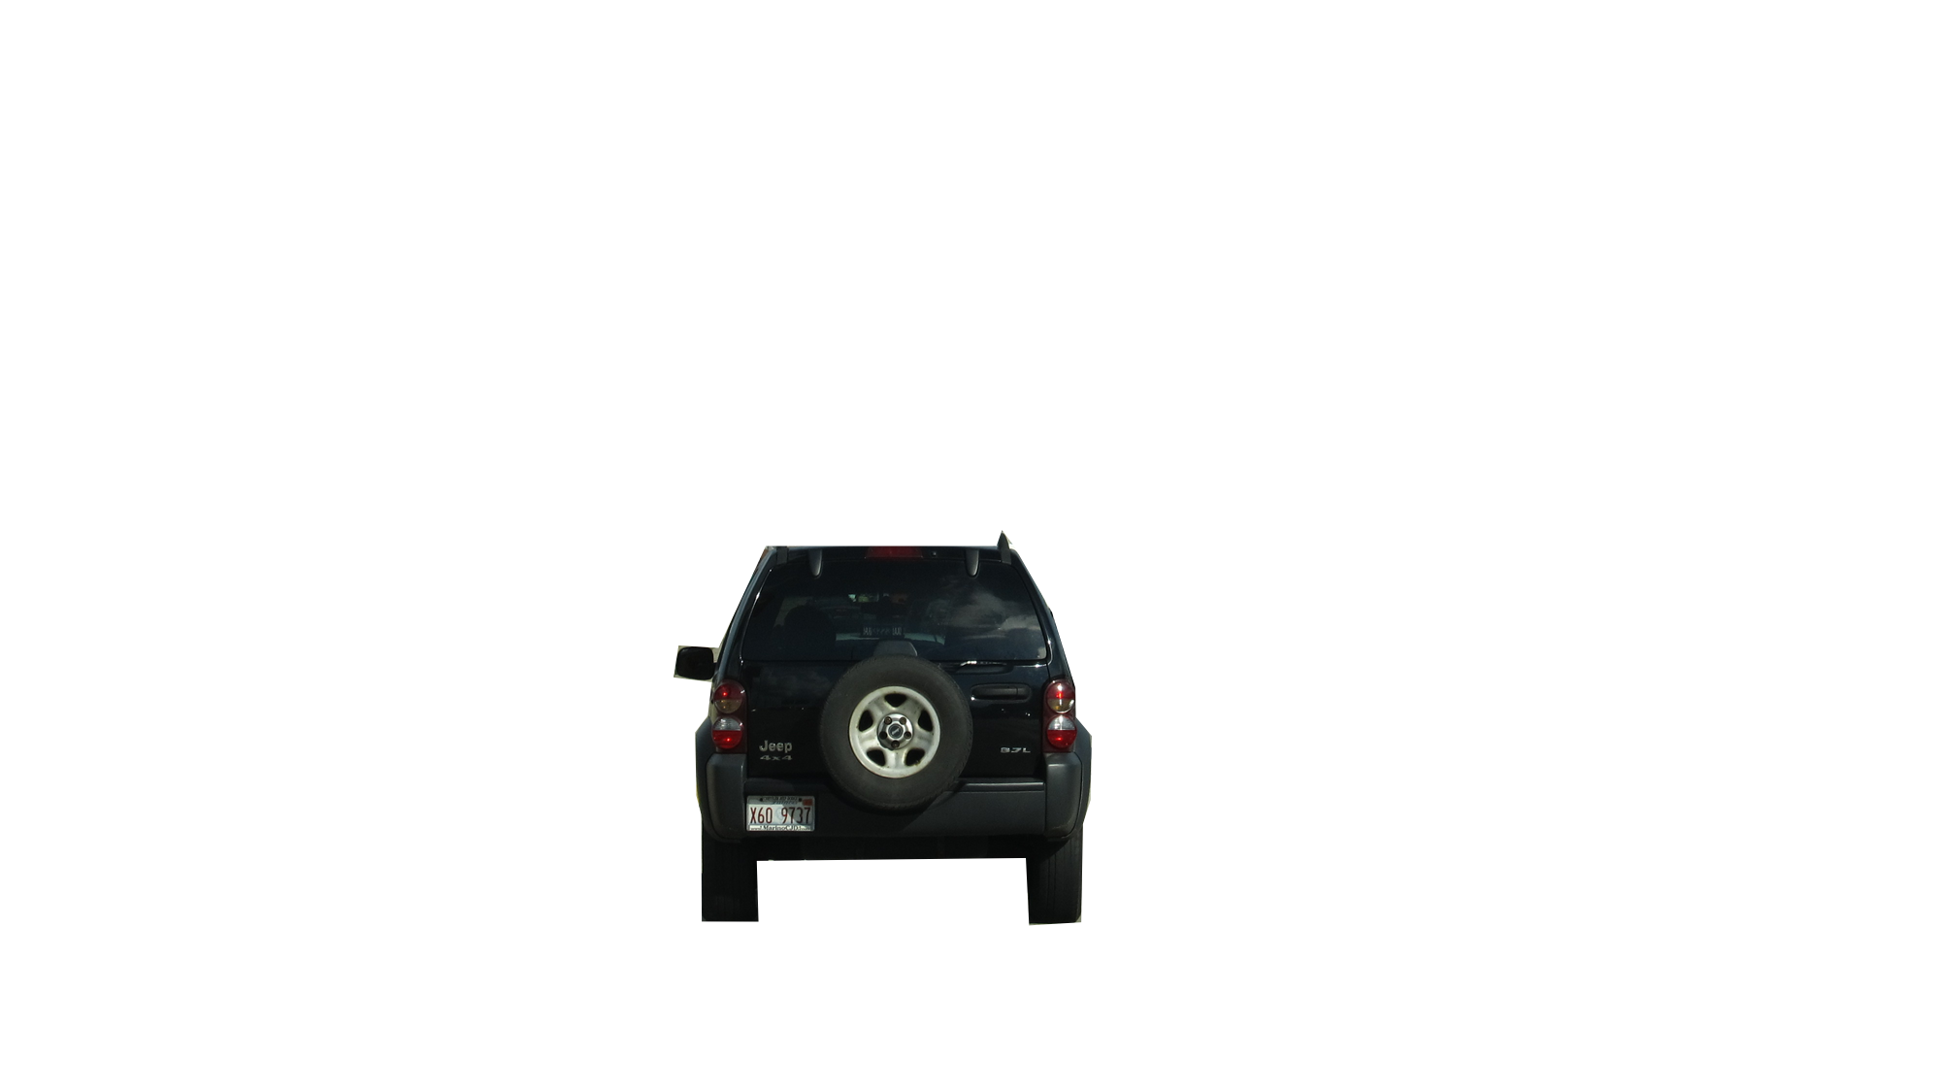
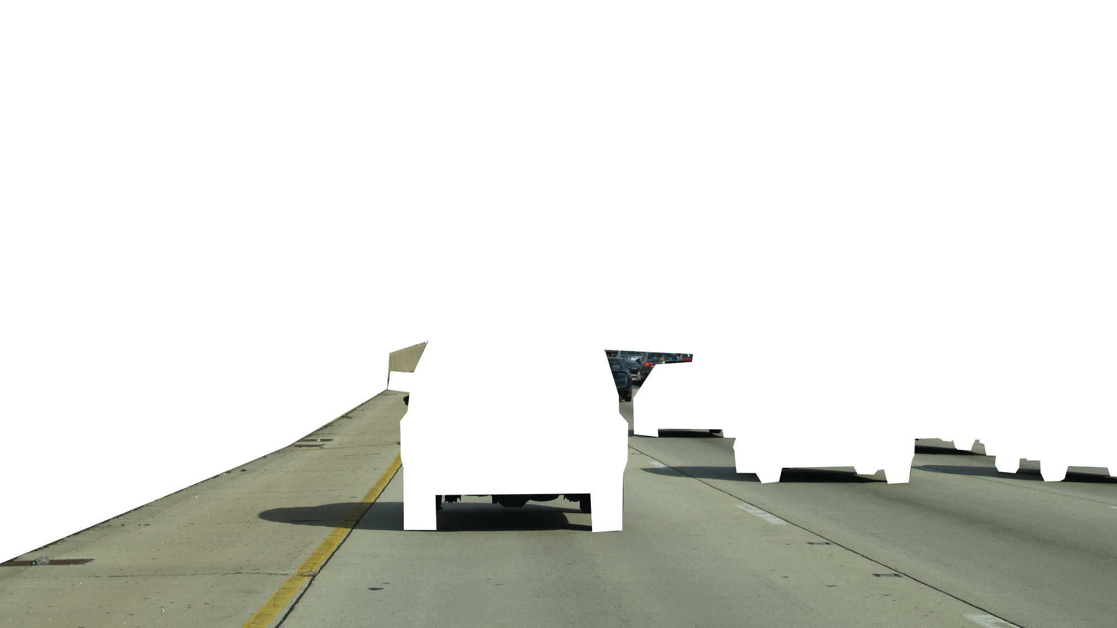
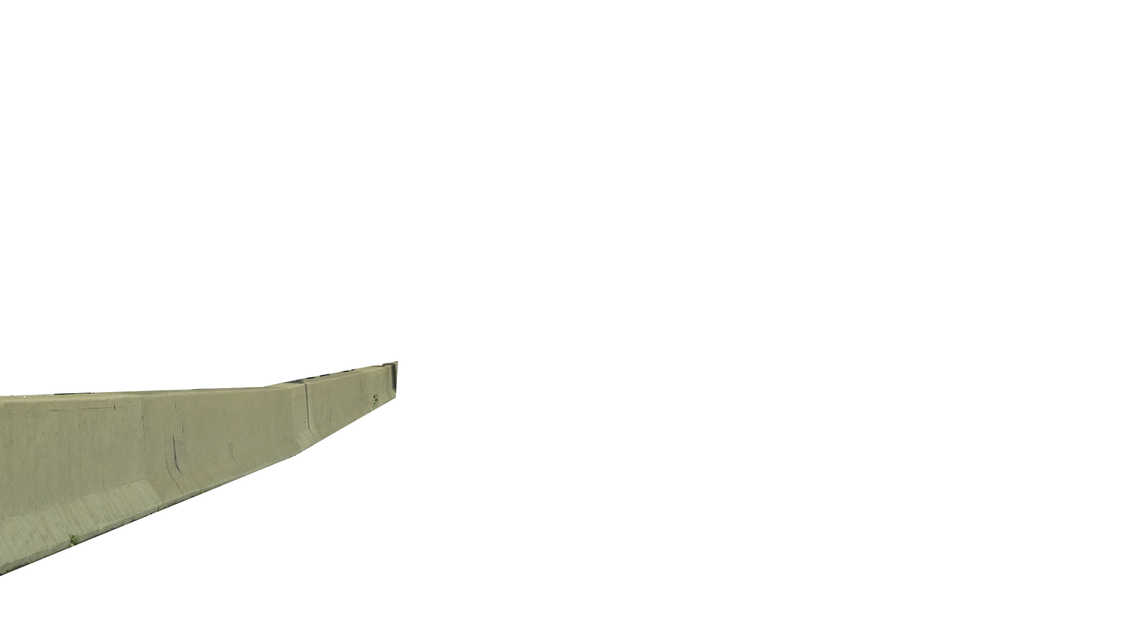
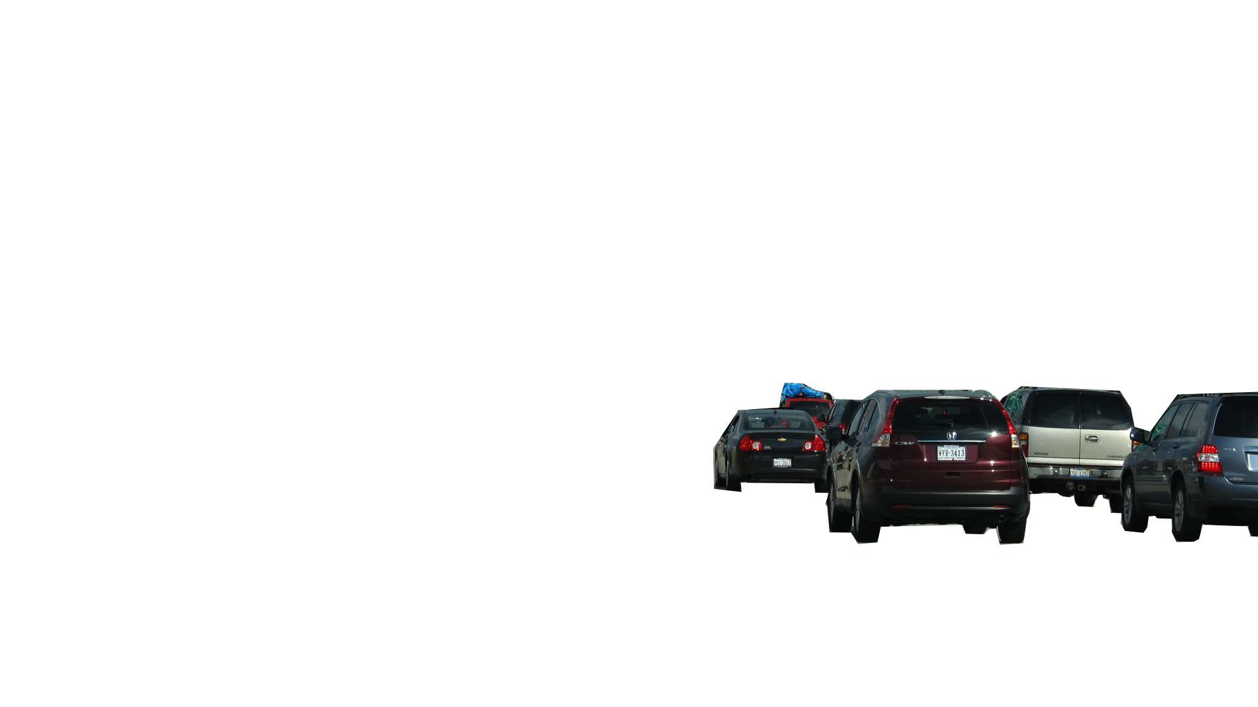
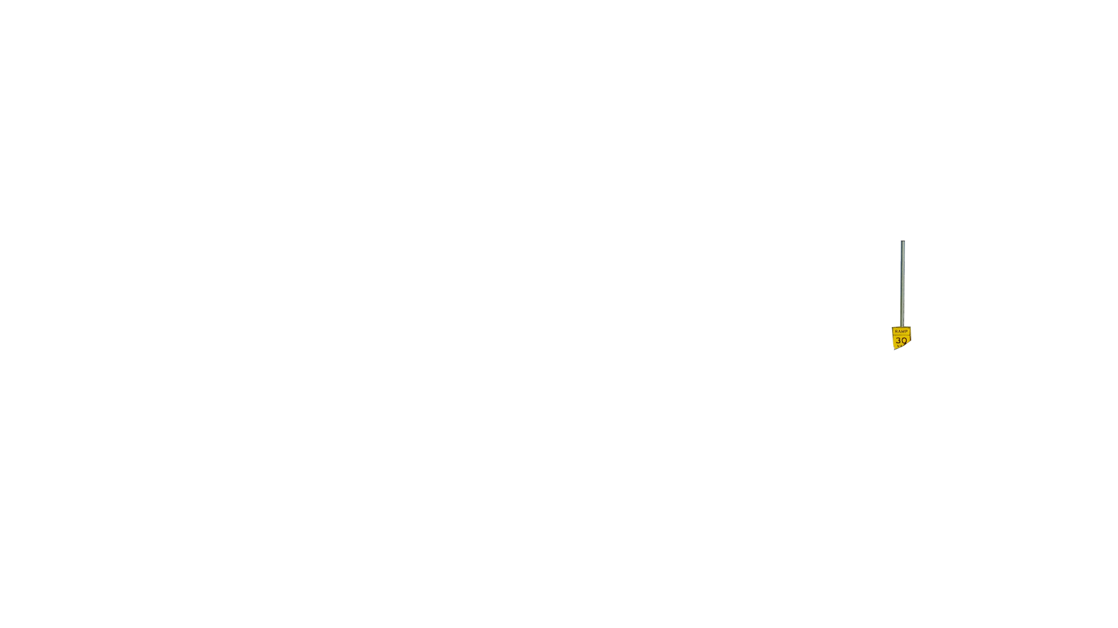
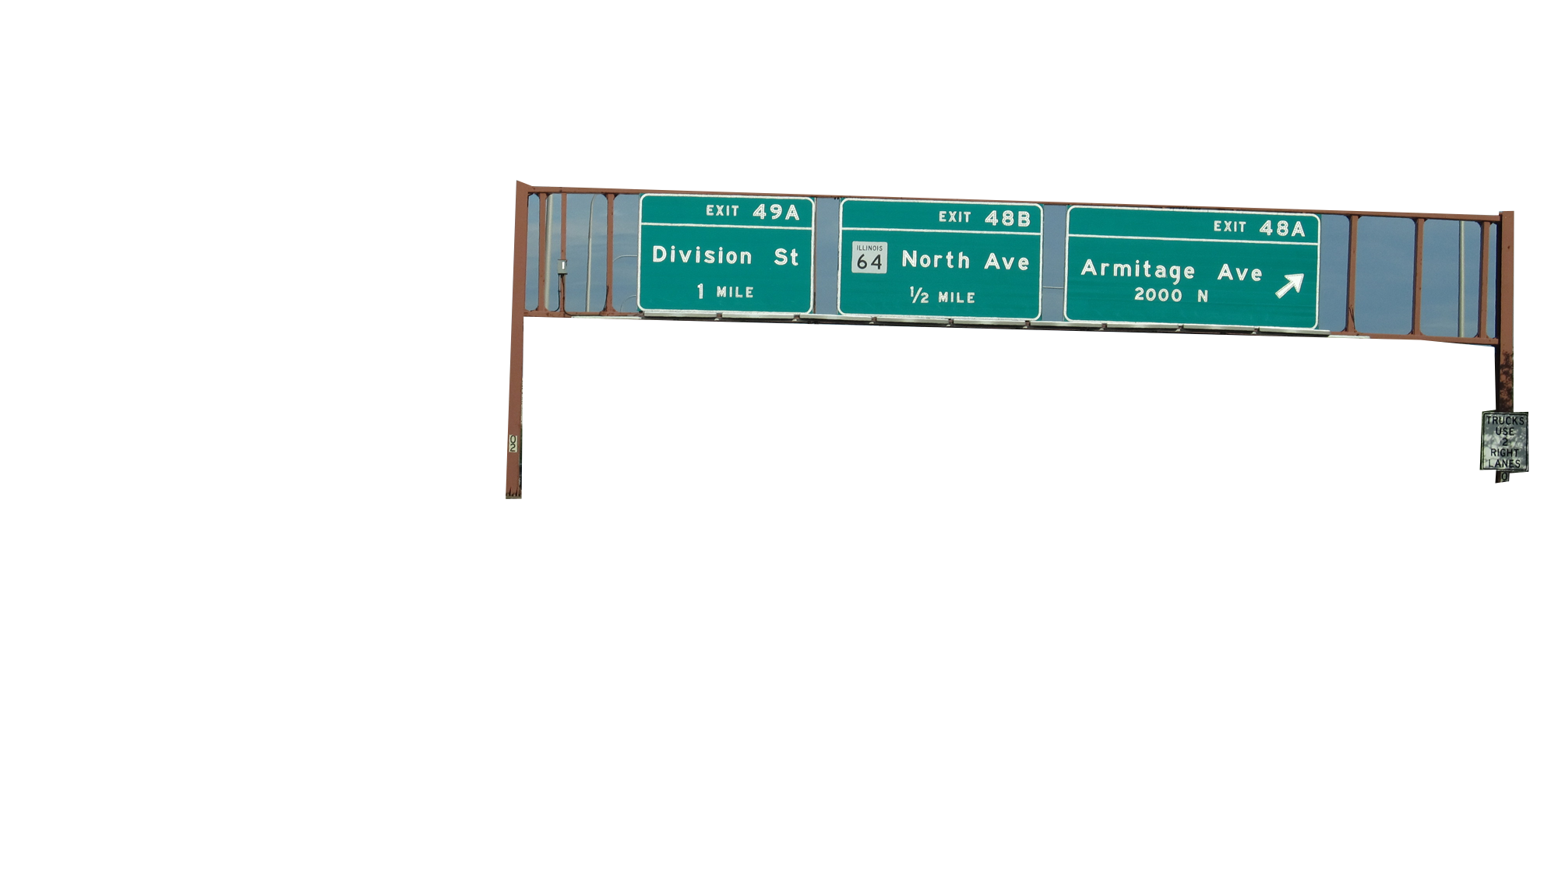
Traffic Sign Recognition
Application
Team 7 Sponsored by: The PFW CS Department
Advisor: Mohammadreza Hajiarbabi

Slide 3
Project Objective
1
2
3
7
4
6
5
8
Notes:
Point out how much visual clutter there is on the road
jacob

Slide 4
Project Objective
1
2
3
7
4
6
5
8
Build an application for new drivers to help manage the stress of driving for the user.
Our application seeks to provide audio feedback to the user regarding road awareness and safety.
Notes:
Point out how much visual clutter there is on the road
jacob

Slide 5
Methodology
Project Objective
Build an application for new drivers to help manage the stress of driving for the user.
Our application seeks to provide audio feedback to the user regarding road awareness and safety.
Notes:
jacob

Slide 6
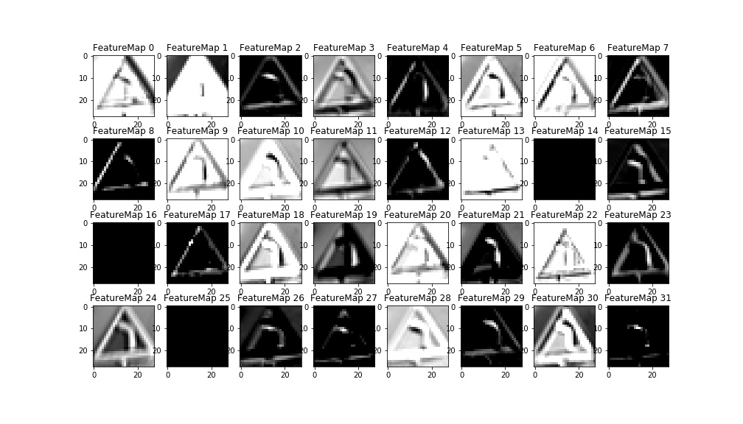
Project Objective
Methodology
GTSRB dataset (German Traffic Sign Recognition Benchmark)
Build an application for new drivers to help manage the stress of driving for the user.
Our application seeks to provide audio feedback to the user regarding road awareness and safety.

Slide 7
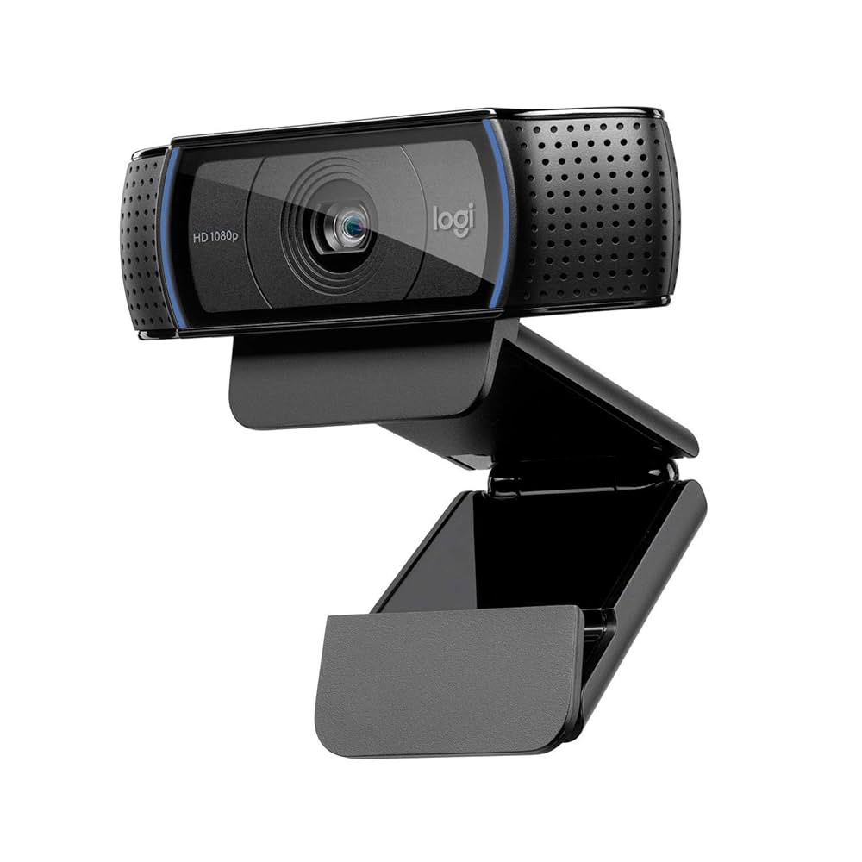

Methodology
GTSRB dataset (German Traffic Sign Recognition Benchmark)

Slide 8
Methodology
GTSRB dataset (German Traffic Sign Recognition Benchmark)

Slide 9
Methodology
GTSRB dataset (German Traffic Sign Recognition Benchmark)

Slide 10







Tools & Technologies
Chaquopy
TKinter
GTSRB dataset
Python
TensorFlow
OpenCV
Notes:
2 minutes
shreya

Slide 11
Tools & Technologies
Chaquopy
TKinter
GTSRB dataset
Python
TensorFlow
OpenCV
Notes:
2 minutes
shreya

Slide 12
Tools & Technologies
Expected Outcome
TKinter
GTSRB dataset
Python
Chaquopy
TensorFlow
OpenCV
Notes:
2 minutes
shreya

Slide 13
Expected Outcome
TKinter
GTSRB dataset
TensorFlow
OpenCV
Goal 1: Create a working application
Goal 2: Obtain hands on experience
Notes:
1 min
hayden

Slide 14
Expected Outcome
A that can
Goal 1: Create a working application
Goal 2: Obtain hands on experience
Notes:
1 min
hayden

Slide 15
Expected Outcome
Goal 1: Create a working application that can
Fvglfkd;gkmf,pq.Rk,oGLGFKDKGwflekwf,w R epkclkascmacalcofmjk,plk,oq:1fhsckmlwqoilskajz RSDF GDFGHFGHdfgdfghfd klmxmzjkn
Fvglfkd;gkmf,pq.Rk,oGLGFKDKGwflekwf,w R epkclkascmacalcofmjk,plk,oq:1fhsckmlwqoilskajz RSDF GDFGHFGHdfgdfghfd klmxmzjkn
Fvglfkd;gkmf,pq.k,oGLGFKDKGwflekwf,wepkclkascmacalcofmjk,plk,oq:1fhsckmlwqoilskajz xmzjkn jhdkalsmjhbayuqhnsakxjzmloqpeij3987wfeuisdkjldqwiouepdiwq jmk,lpk,omjinpl,omjinhubyvtcrxzawsewazxseezawexsrcdsexazwesxdcrsxeazrdctfvytcdrxserdctfvygbunhubgvfyctdxrszewqAZERSfvybgunhimjok,pl.pk,omjinhbugyvftcdrxswzaeqesxrdctfvygbunhijmok,jnhbgvyfrtcexzwrxcdtfvygbunhijmok,pljmnihybgtufr6de5s4wzxrcdtfvygbunhjmkhubgyvftcdrxsezawxsedcrfvtgybhunijokplkq jmoihweugcdnhslkerjmnhiteijmowk,pe,rmjc,pejmroinhjklx[kemrjnihok
Goal 2: Obtain hands on experience
Notes:
1 min
hayden

Slide 16
Expected Outcome
Goal 1: Create a working application that can
Recognize traffic signs in real time
Fvglfkd;gkmf,pq.Rk,oGLGFKDKGwflekwf,w R epkclkascmacalcofmjk,plk,oq:1fhsckmlwqoilskajz RSDF GDFGHFGHdfgdfghfd klmxmzjkn
Fvglfkd;gkmrrrf,pq.Rk,oGLGFKDKGwflekwf,w R/asdlkfjhseduifjoken klstrtrta epkclPSDPgfdklgybuvnivemop,akascmacalcofmjk,plk,oq:1fhsckmlwqoilskajz RSDF GDFGHFGHdfgdfghfd klmxmzjkn
Notes:
1 min
hayden

Slide 17
Expected Outcome
Goal 1: Create a working application that can
Recognize traffic signs in real time
Provide visual and/or audio alerts
Goal 2: Obtain hands on experience with
Computer Vision
AI Model Training
Python Based Application Development
Notes:
1 min
hayden

Slide 18
Expected Outcome
Team Roles
Goal 2: Obtain hands on experience with
CNN may be too slow for live video on phones
Poor lighting and motion blur may cause misclassification
Limited time in the semester to complete the application
Varying Image/Video Quality
Risk
Computer Vision
AI Model Training
Python Based Application Development
Goal 1: Create a working application that can
Recognize traffic signs in real time
Provide visual and/or audio alerts
Notes:
1 min
hayden

Slide 19
CNN may be too slow for live video on phones
Poor lighting and motion blur may cause misclassification
Limited time in the semester to complete the application
Varying Image/Video Quality
Risk

Slide 20
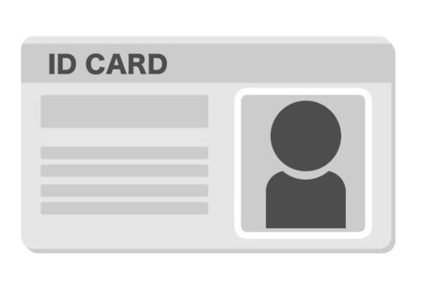
Team Roles
Expected
Outcome
CNN may be too slow for live video on phones
Poor lighting and motion blur may cause misclassification
Limited time in the semester to complete the application
Varying Image/Video Quality
Risk
Team Leader
Rishi
Oversee Project Manager
ML model training
Notes:
45 sec
Introduce project sponsor here
rishi

Slide 21
Team Roles
Team Leader
Rishi
Oversee Project Manager
ML model training
Aidan
ML Model Training
Backend Development
Notes:
45 sec
Introduce project sponsor here
rishi

Slide 22
Team Roles
Aidan
ML Model Training
Backend Development
Team Leader
Rishi
Oversee Project Manager
ML model training
Jacob
UI + UX
Testing
Notes:
45 sec
Introduce project sponsor here
rishi

Slide 23
Team Roles
Jacob
UI + UX
Testing
Aidan
ML Model Training
Backend Development
Implementation
Hayden
Testing
Notes:
45 sec
Introduce project sponsor here
rishi

Slide 24
Team Roles
Hayden
Testing
Implementation
Jacob
UI + UX
Testing
Shreya
UI + UX
Datasets
Validation
Notes:
45 sec
Introduce project sponsor here
rishi

Slide 25
Team Roles
Shreya
UI + UX
Datasets
Validation
Hayden
Testing
Implementation
Timeline
Notes:
45 sec
Introduce project sponsor here
rishi

Slide 26
Team Roles
Data Set Collection
Image Preprocess
Baseline Training
Timeline
Shreya
UI + UX
Datasets
Validation

Slide 27
Realtime Detection
Model Integration
Data Set Collection
Image Preprocess
Baseline Training
Timeline

Slide 28
UI Development
Initial Testing
Refinement
Data Set Collection
Image Preprocess
Baseline Training
Realtime Detection
Model Integration
Timeline

Slide 29
Final Evaluation
Report Preparation
Demo
Presentation
Data Set Collection
Image Preprocess
Baseline Training
UI Development
Initial Testing
Refinement
Realtime Detection
Model Integration
Timeline

Slide 30
Final Evaluation
Report Preparation
Demo
Presentation
Data Set Collection
Image Preprocess
Baseline Training
UI Development
Initial Testing
Refinement
Realtime Detection
Model Integration
Timeline

Slide 31
Closing Remarks
Timeline
Notes:
Remaining time + Q/A Aidan

